Slide 1
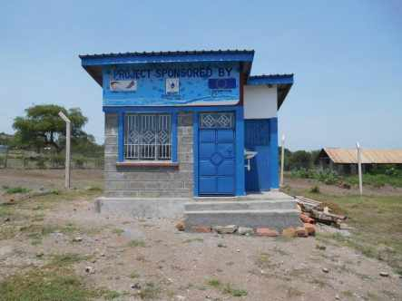
OPERATOR STORE
TECHNICAL SPECIFICATION AND REQUIREMENTS

Slide 2
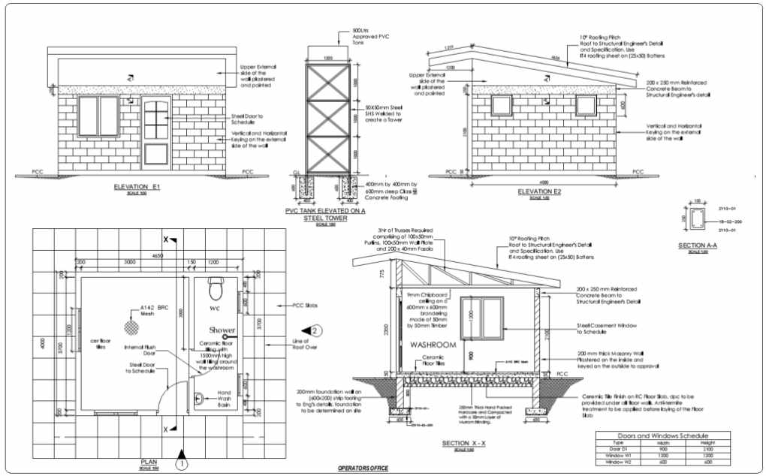

Slide 3
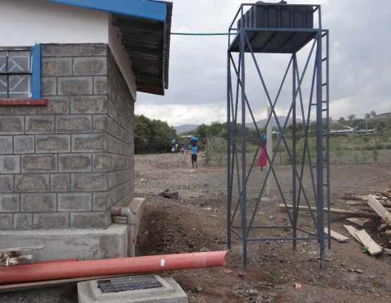
WATER SUPPLY
Water for sink and toilet:
Connect water supply to the site including the installation of a 500L water tank elevated on a steel tower

Slide 4
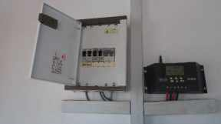
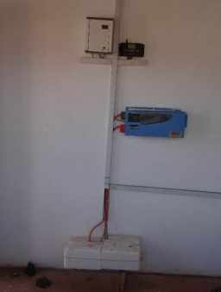
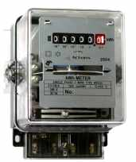
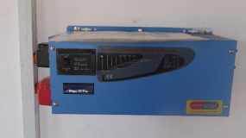
ELECTRICITY SUPPLY
Electricity for office and bathroom: 2 bulbs, 2 switch buttons, 3 double electrical sockets:
electrical connection including complete meter connection with meter box (KPLC), compact switch board, or
50W Solar Panel with 10A solar charge controller, 12V battery and inverter

